Slide 1
What is Git?
A fearless adventure into revision control.

Slide 2

According to Wikipedia…
Git is a distributed revision control system with an emphasis on speed, data integrity, and support for distributed, non-linear workflows. Git was initially designed and developed by Linus Torvalds for Linux kernel development in 2005, and has since become one of the most widely adopted version control systems for software development.
Revision control, also known as version control or source control, is the management of changes to documents, computer programs, and other collections of information. Changes are usually identified by a number or letter code, termed the "revision number," "revision level," or simply "revision.”

Slide 3
Wat?
It keeps a history of every change you make.

Slide 4
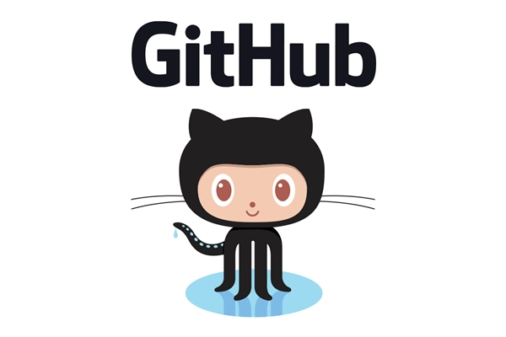

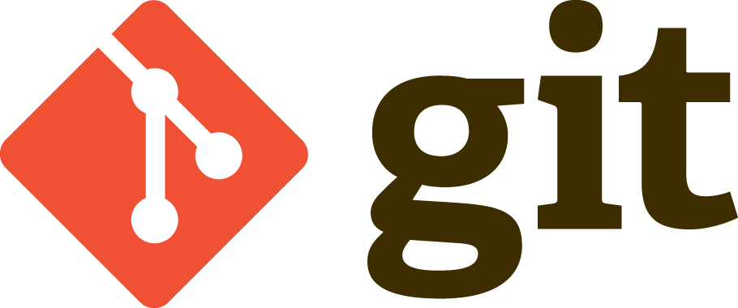
GitHubs. Yeah. I’ve heard of those.

Slide 5
Won’t this be a pain?
When you clone a repository, you have the full project on your local machine.
Repositories can be cloned over and over again by an infinite number of contributors on an infinite number of machines with no impact to performance.
You can work in a repository offline as much as you want.
An Internet connection is only required to push changes.

Slide 6
Repositories? What are those things?
Repositories are projects that are actively being tracked in git.
Generally speaking, there are at least a couple of these. But there doesn’t have to be.

Slide 7

Why would I use this if I am working alone?

Slide 8
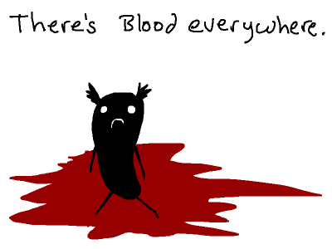

Slide 9


Slide 10

Branches. All the branches.
Branches are like having different versions of your project at the same time.
Branches keep you from stepping on another person’s toes when working on the same files.
Branches let you experiment.

Slide 11
So how does this work?
This is the part where I show you how you might use this.
(we can close this presentation now)
kthxbai

